Slide 1

ISRAEL ECONOMY ANALYSIS
Data Science
Presented By:
Idan Refaeli, Adir Elmakyes, Ron Kipnis
Notes:
https://www.freepik.com/free-vector/business-meeting-sketch-concept-with-top-view-human-hands-with-office-objects_2873560.htm#page=1&query=sketch&position=29

Slide 2






Data Scraping
EDA
Conclusions
Timeline
Raising Research Questions
Data Handling
Machine Learning

Slide 3

Raising Research Questions
Notes:
https://www.freepik.com/free-vector/business-meeting-sketch-concept-with-top-view-human-hands-with-office-objects_2873560.htm#page=1&query=sketch&position=28

Slide 4

The Prediction Questions
We chose the economic issue because of the great interest in the functioning of the Israeli economy and high-tech in particular.
The questions we asked deal with key issues in economics. Such as salary, general satisfaction, and early resignation.
Can we predict the salaries in the Israeli High-Tech Industry?
Can we predict the early resignation of workers in the Israeli economy?
Can we predict whether an employee is satisfied by their review?

Slide 5

Data Scraping
Notes:
https://www.freepik.com/free-vector/business-meeting-sketch-concept-with-top-view-human-hands-with-office-objects_2873560.htm#page=1&query=sketch&position=28

Slide 6


Data Source
We built a bot with the help of selenium, the bot goes into the position required to retrieve the information.
It took us about two hours to pull out all the information.

Slide 7
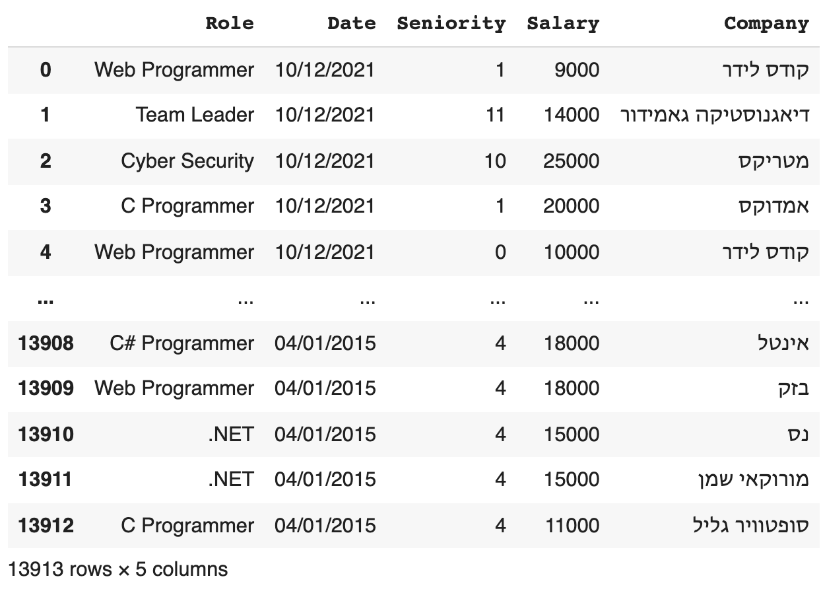
Data Scraped – High Tech Data
Notes:
https://www.freepik.com/free-vector/business-meeting-sketch-concept-with-top-view-human-hands-with-office-objects_2873560.htm#page=1&query=sketch&position=28

Slide 8
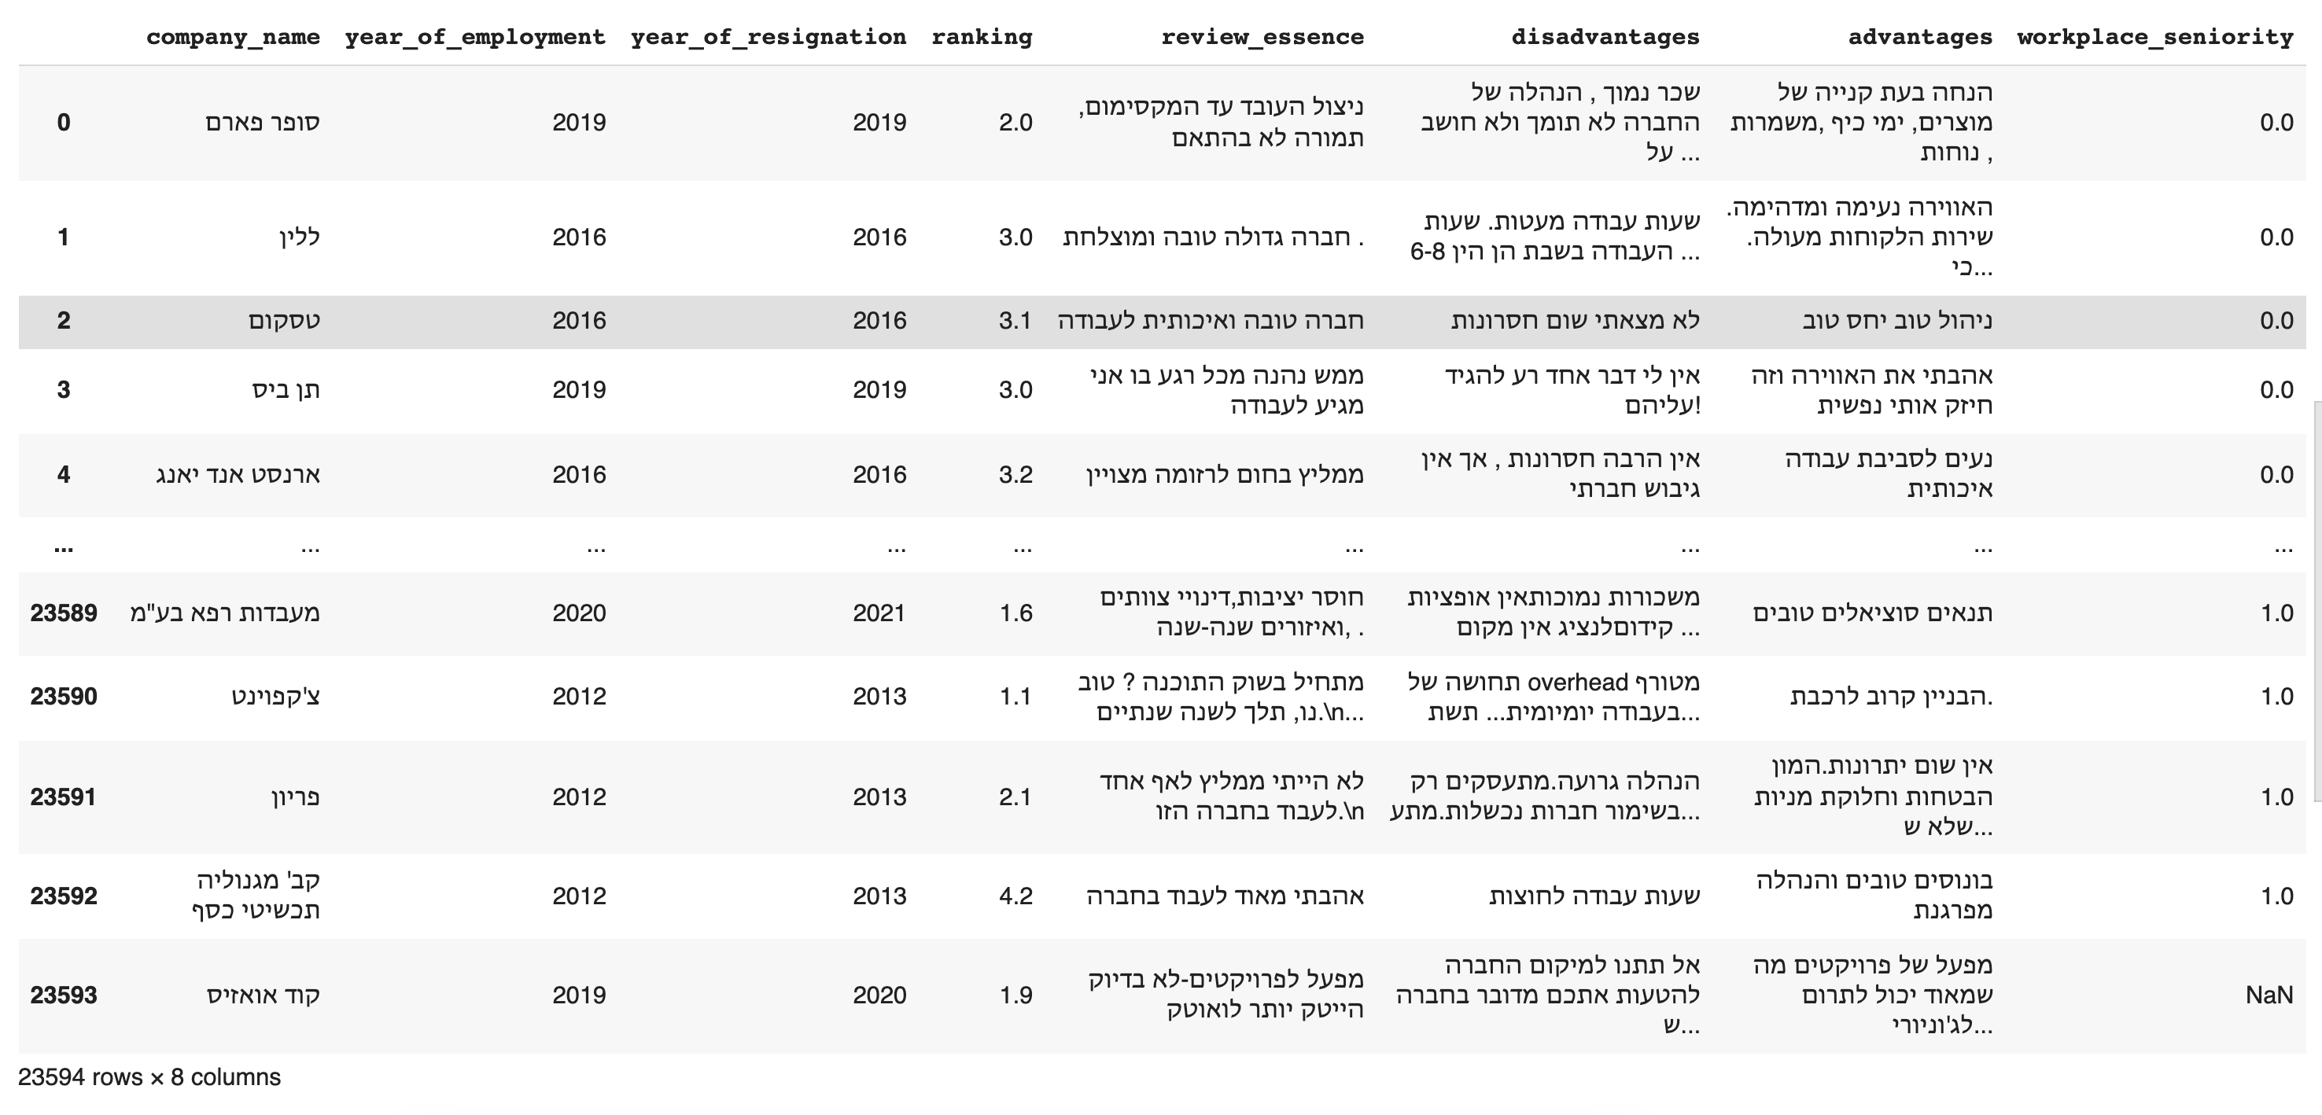
Data Scraped – Whole Economy Data
Notes:
https://www.freepik.com/free-vector/business-meeting-sketch-concept-with-top-view-human-hands-with-office-objects_2873560.htm#page=1&query=sketch&position=28

Slide 9
How We Did It?
We used python scraping library BeautifulSoup
We used Selenium Get to receive a request from the website https://theworker.co.il.
We built a bot with the help of Selenium that knows how to access the places required for the purpose of acquiring the data.
When the bot got to the required place, we used the BeautifulSoup library to acquire data and save it within lists.
We built a total of 2 bots, each bot has a site login functionality defined using a real username and password.
Dedicated bot for each task, the first task was to acquire the data of the whole economy, this task was quite easy, since all the data are under one category that centralizes all the information.
The second task focused on acquiring data from high-tech companies, this task was a bit more complex, we had to switch between different categories for the purpose of acquiring different role data, for this purpose we put in the bot the appropriate addresses of each category.
Finally we saved the information in dict, and converted to DataFrame while saving the information in a csv file.
Notes:
https://www.freepik.com/free-vector/business-meeting-sketch-concept-with-top-view-human-hands-with-office-objects_2873560.htm#page=1&query=sketch&position=28

Slide 10
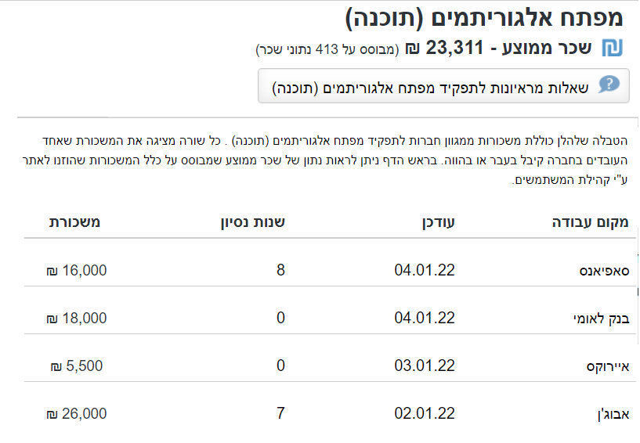
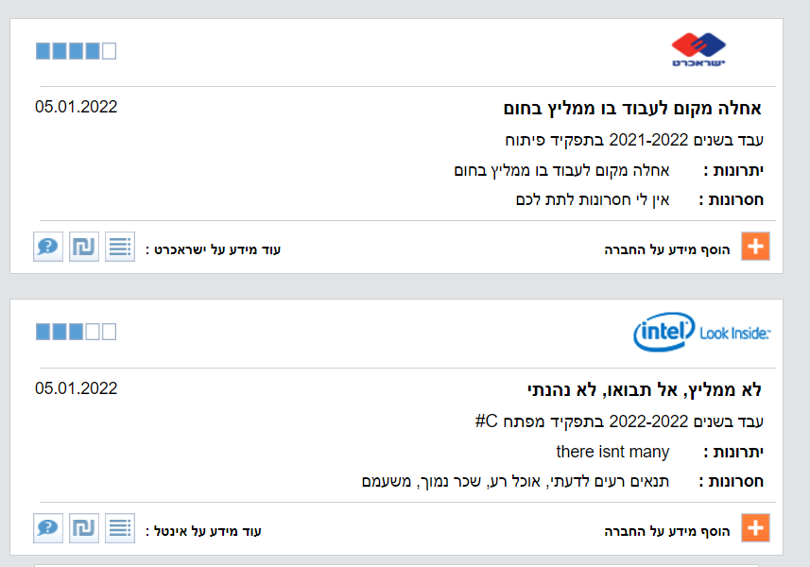

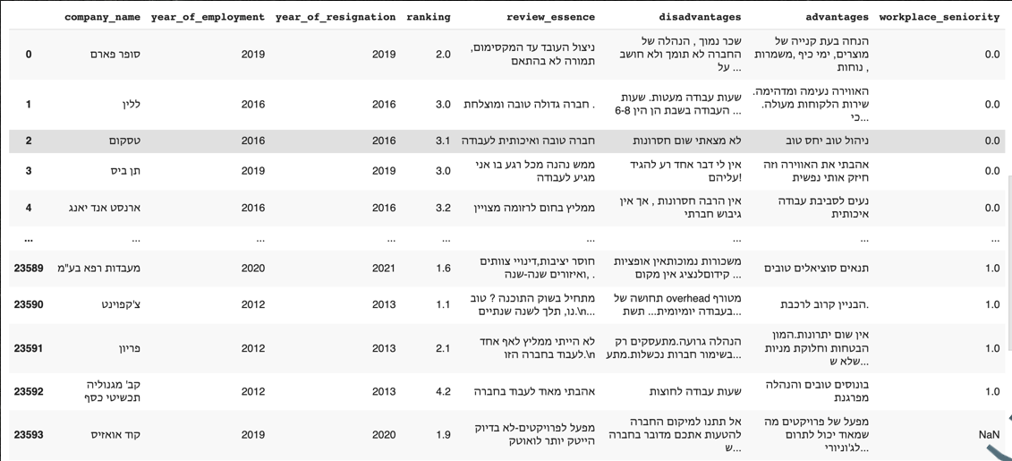
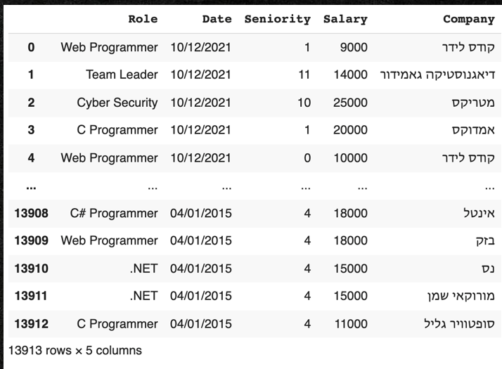
Visual Illustration Of The Process
Notes:
https://www.freepik.com/free-vector/business-meeting-sketch-concept-with-top-view-human-hands-with-office-objects_2873560.htm#page=1&query=sketch&position=28

Slide 11

Data Handling
Notes:
https://www.freepik.com/free-vector/business-meeting-sketch-concept-with-top-view-human-hands-with-office-objects_2873560.htm#page=1&query=sketch&position=28

Slide 12
Cleaning The Data
We had over 250,000 data pieces.
We had to remove a few duplicated rows.
Fill in missing values (in the Seniority column) for that purpose we took the “mean” value.
In the Salaries column there were many “outliers” we took care of, so that the information
will be as legit as possible.
Many users were confused, entering “Start Year” values instead of “Finished Year Of Employment”, so we swapped the values.
All the parameters were Strings, so we converted them to Integers in order to use them in the Machine Learning part of the project
Notes:
https://www.freepik.com/free-vector/business-meeting-sketch-concept-with-top-view-human-hands-with-office-objects_2873560.htm#page=1&query=sketch&position=28

Slide 13
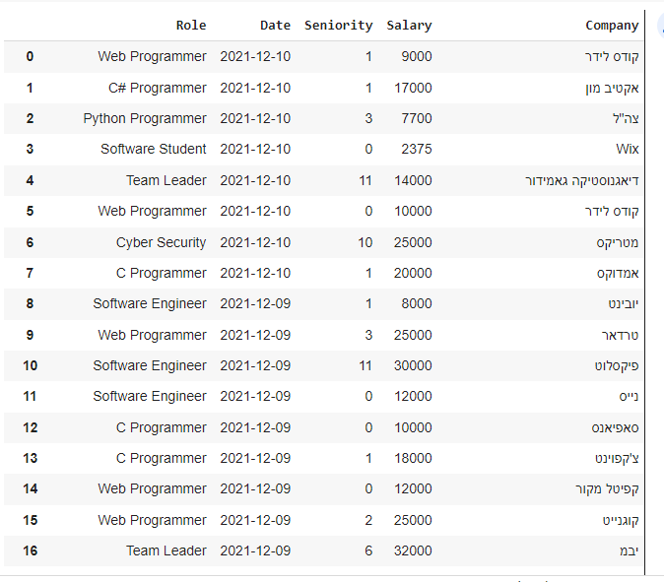
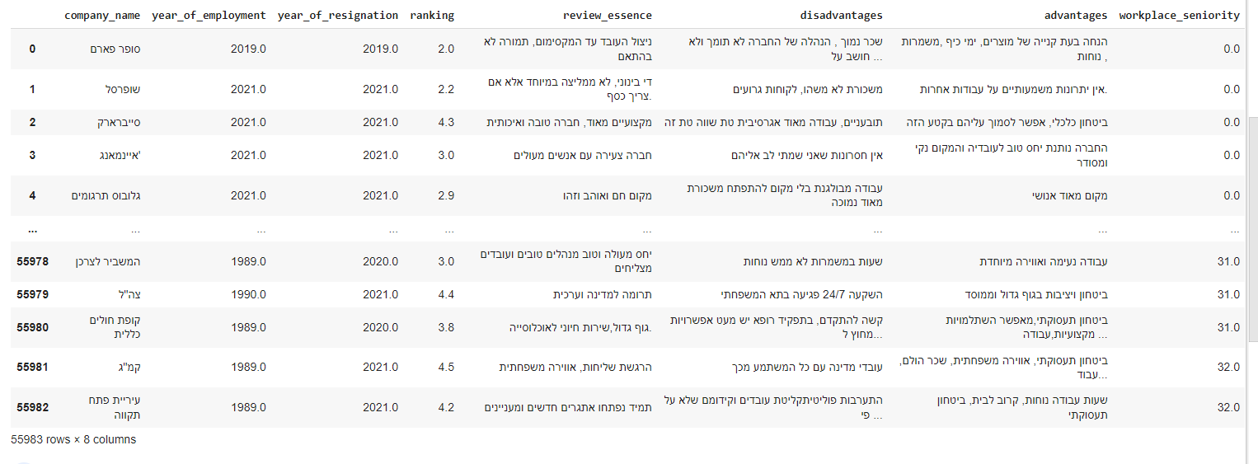
Cleaned Data Illustration
Notes:
https://www.freepik.com/free-vector/business-meeting-sketch-concept-with-top-view-human-hands-with-office-objects_2873560.htm#page=1&query=sketch&position=28

Slide 14


EXPLORATORY DATA ANALYSIS
Notes:
https://www.freepik.com/free-vector/business-meeting-sketch-concept-with-top-view-human-hands-with-office-objects_2873560.htm#page=1&query=sketch&position=28

Slide 15
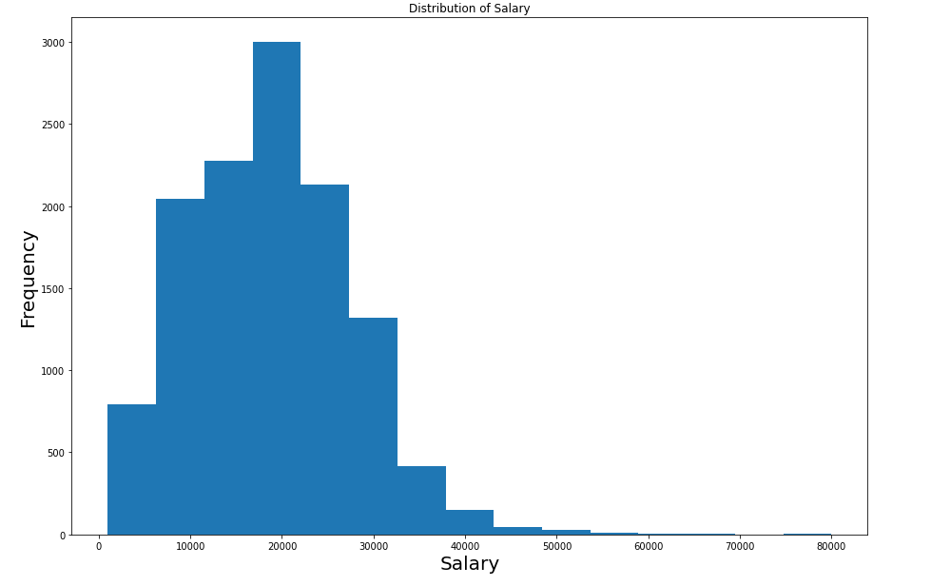
EXPLORATORY DATA ANALYSIS
High Tech Data
Notes:
https://www.freepik.com/free-vector/business-meeting-sketch-concept-with-top-view-human-hands-with-office-objects_2873560.htm#page=1&query=sketch&position=28

Slide 16
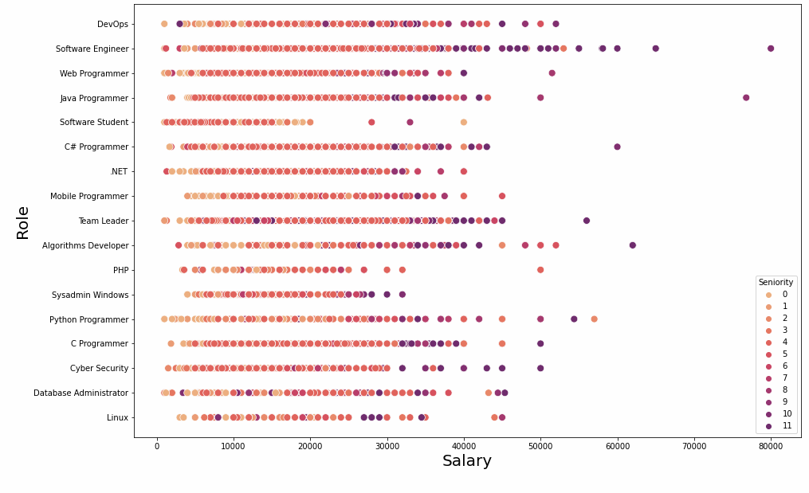
EXPLORATORY DATA ANALYSIS
High Tech Data
Notes:
https://www.freepik.com/free-vector/business-meeting-sketch-concept-with-top-view-human-hands-with-office-objects_2873560.htm#page=1&query=sketch&position=28

Slide 17
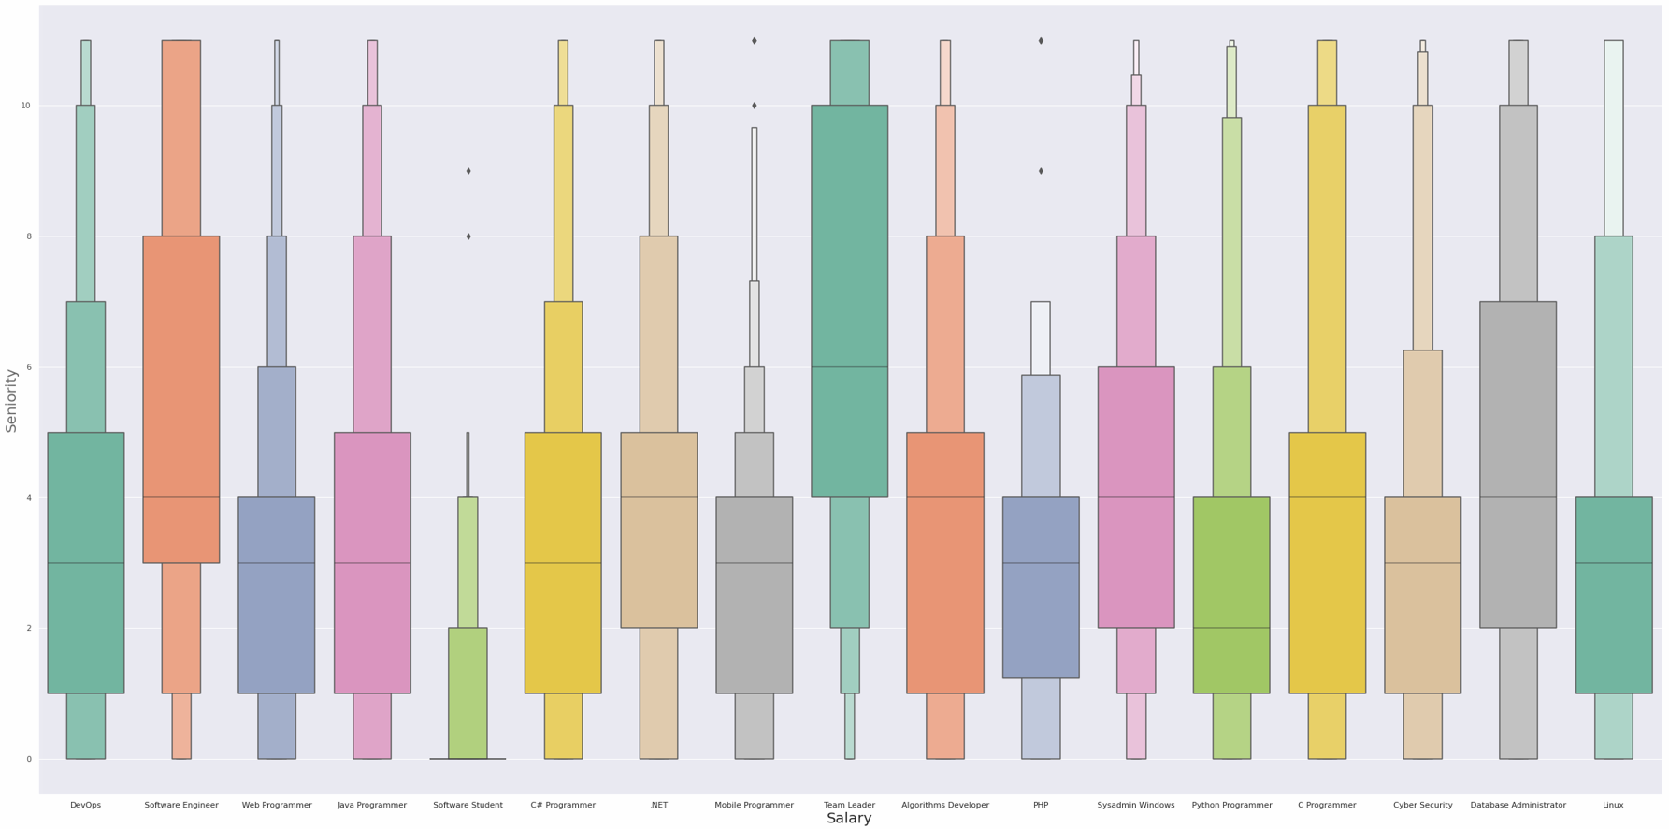
EXPLORATORY DATA ANALYSIS
High Tech Data
Notes:
https://www.freepik.com/free-vector/business-meeting-sketch-concept-with-top-view-human-hands-with-office-objects_2873560.htm#page=1&query=sketch&position=28

Slide 18
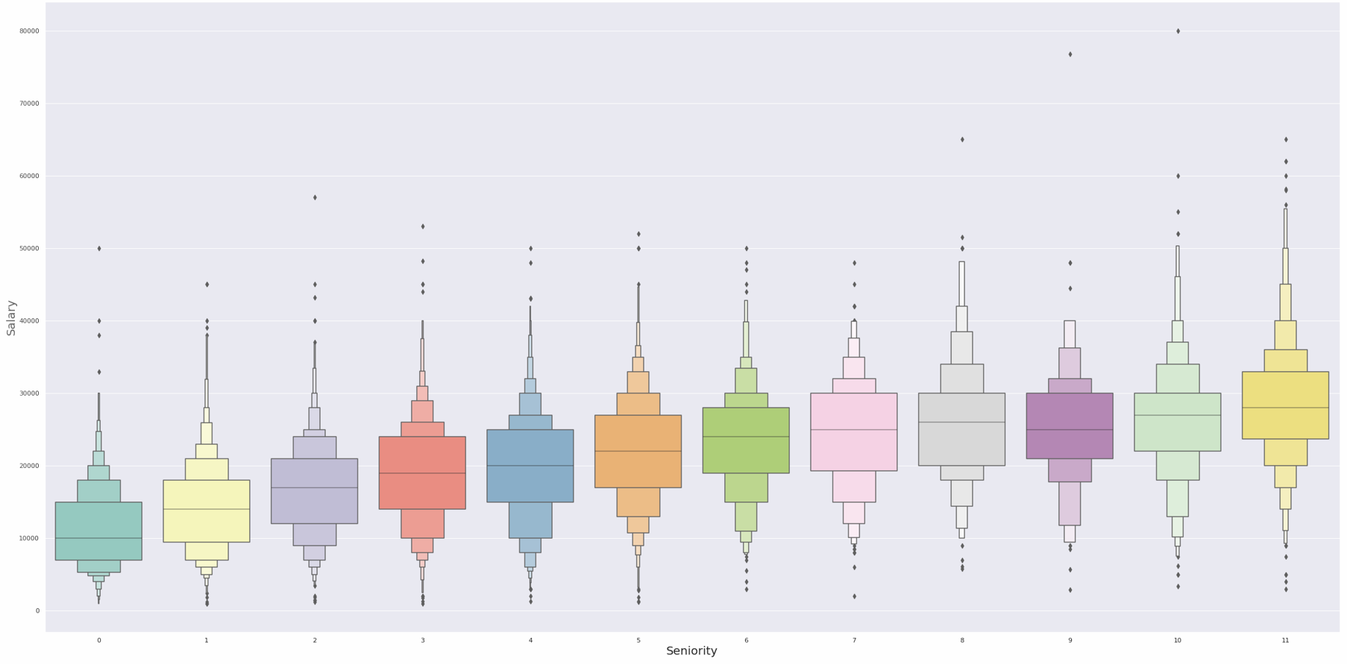
EXPLORATORY DATA ANALYSIS
High Tech Data
Notes:
https://www.freepik.com/free-vector/business-meeting-sketch-concept-with-top-view-human-hands-with-office-objects_2873560.htm#page=1&query=sketch&position=28

Slide 19
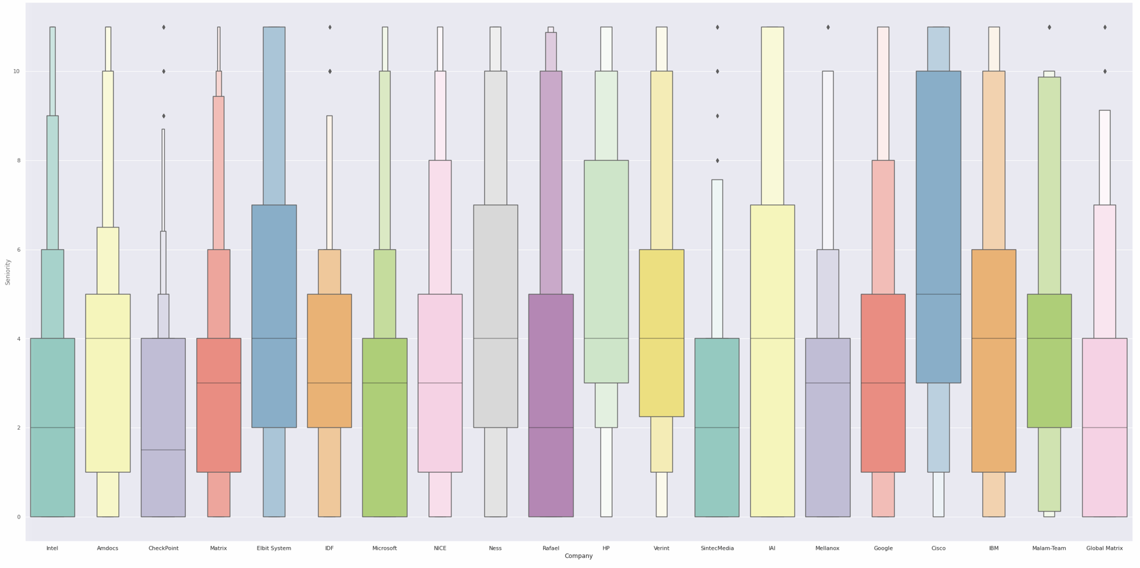
EXPLORATORY DATA ANALYSIS
High Tech Data
Notes:
https://www.freepik.com/free-vector/business-meeting-sketch-concept-with-top-view-human-hands-with-office-objects_2873560.htm#page=1&query=sketch&position=28

Slide 20
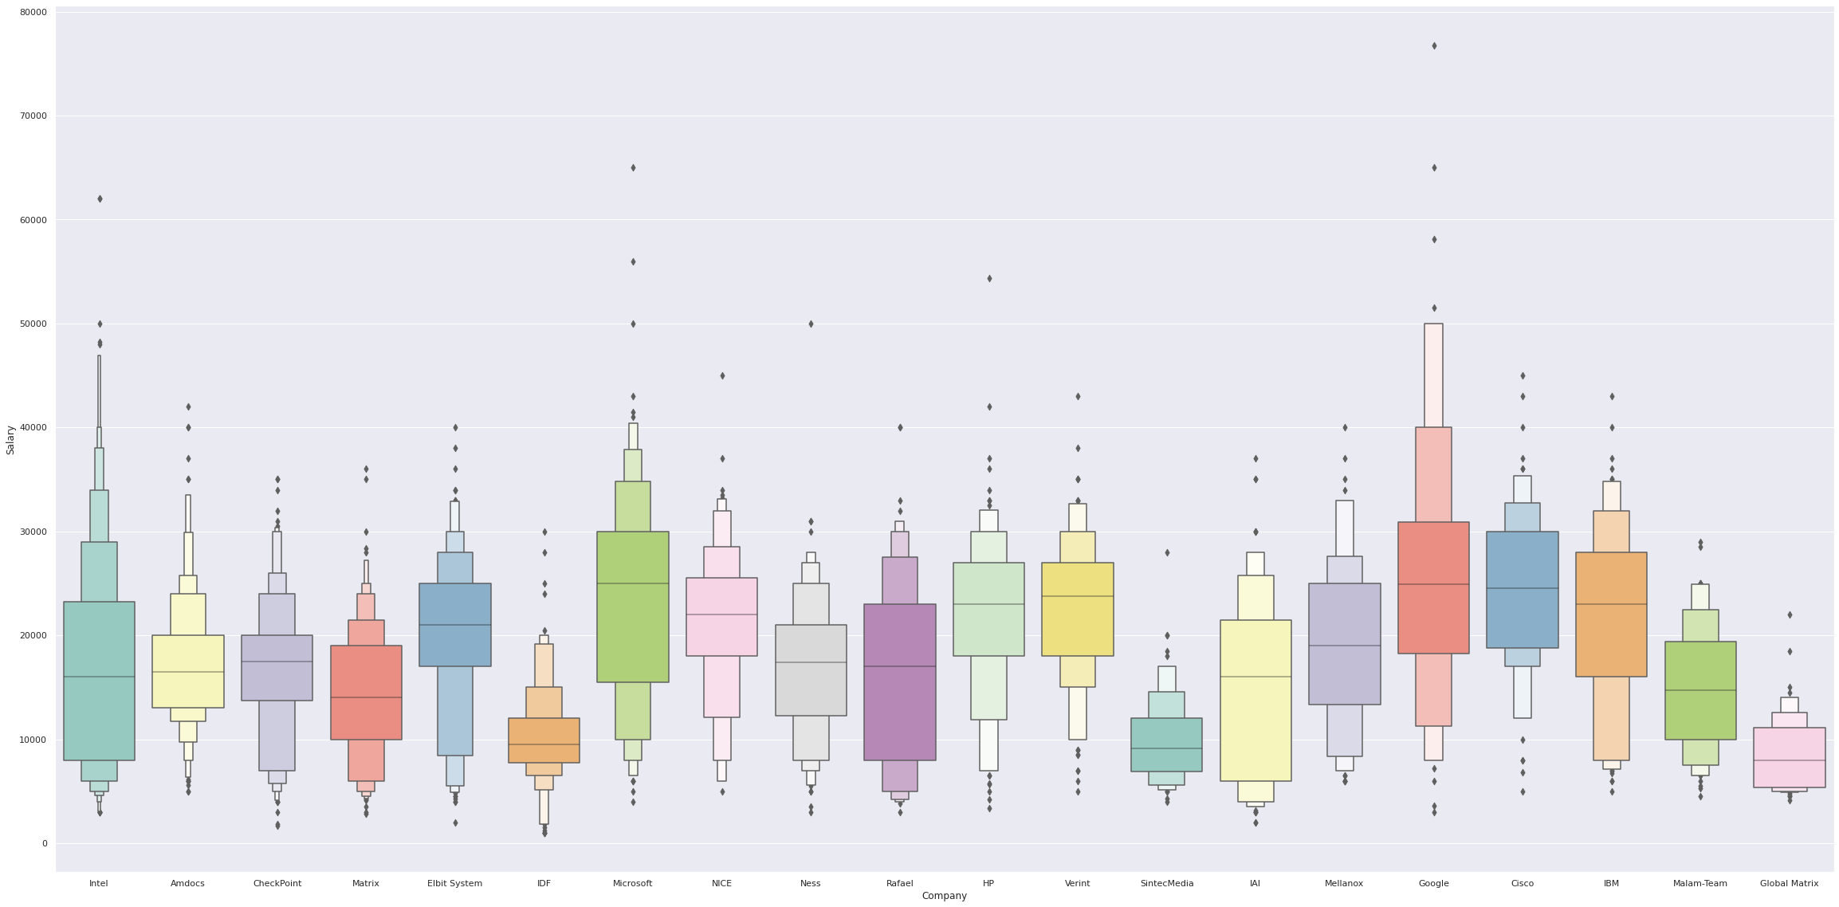
EXPLORATORY DATA ANALYSIS
High Tech Data
Notes:
https://www.freepik.com/free-vector/business-meeting-sketch-concept-with-top-view-human-hands-with-office-objects_2873560.htm#page=1&query=sketch&position=28

Slide 21
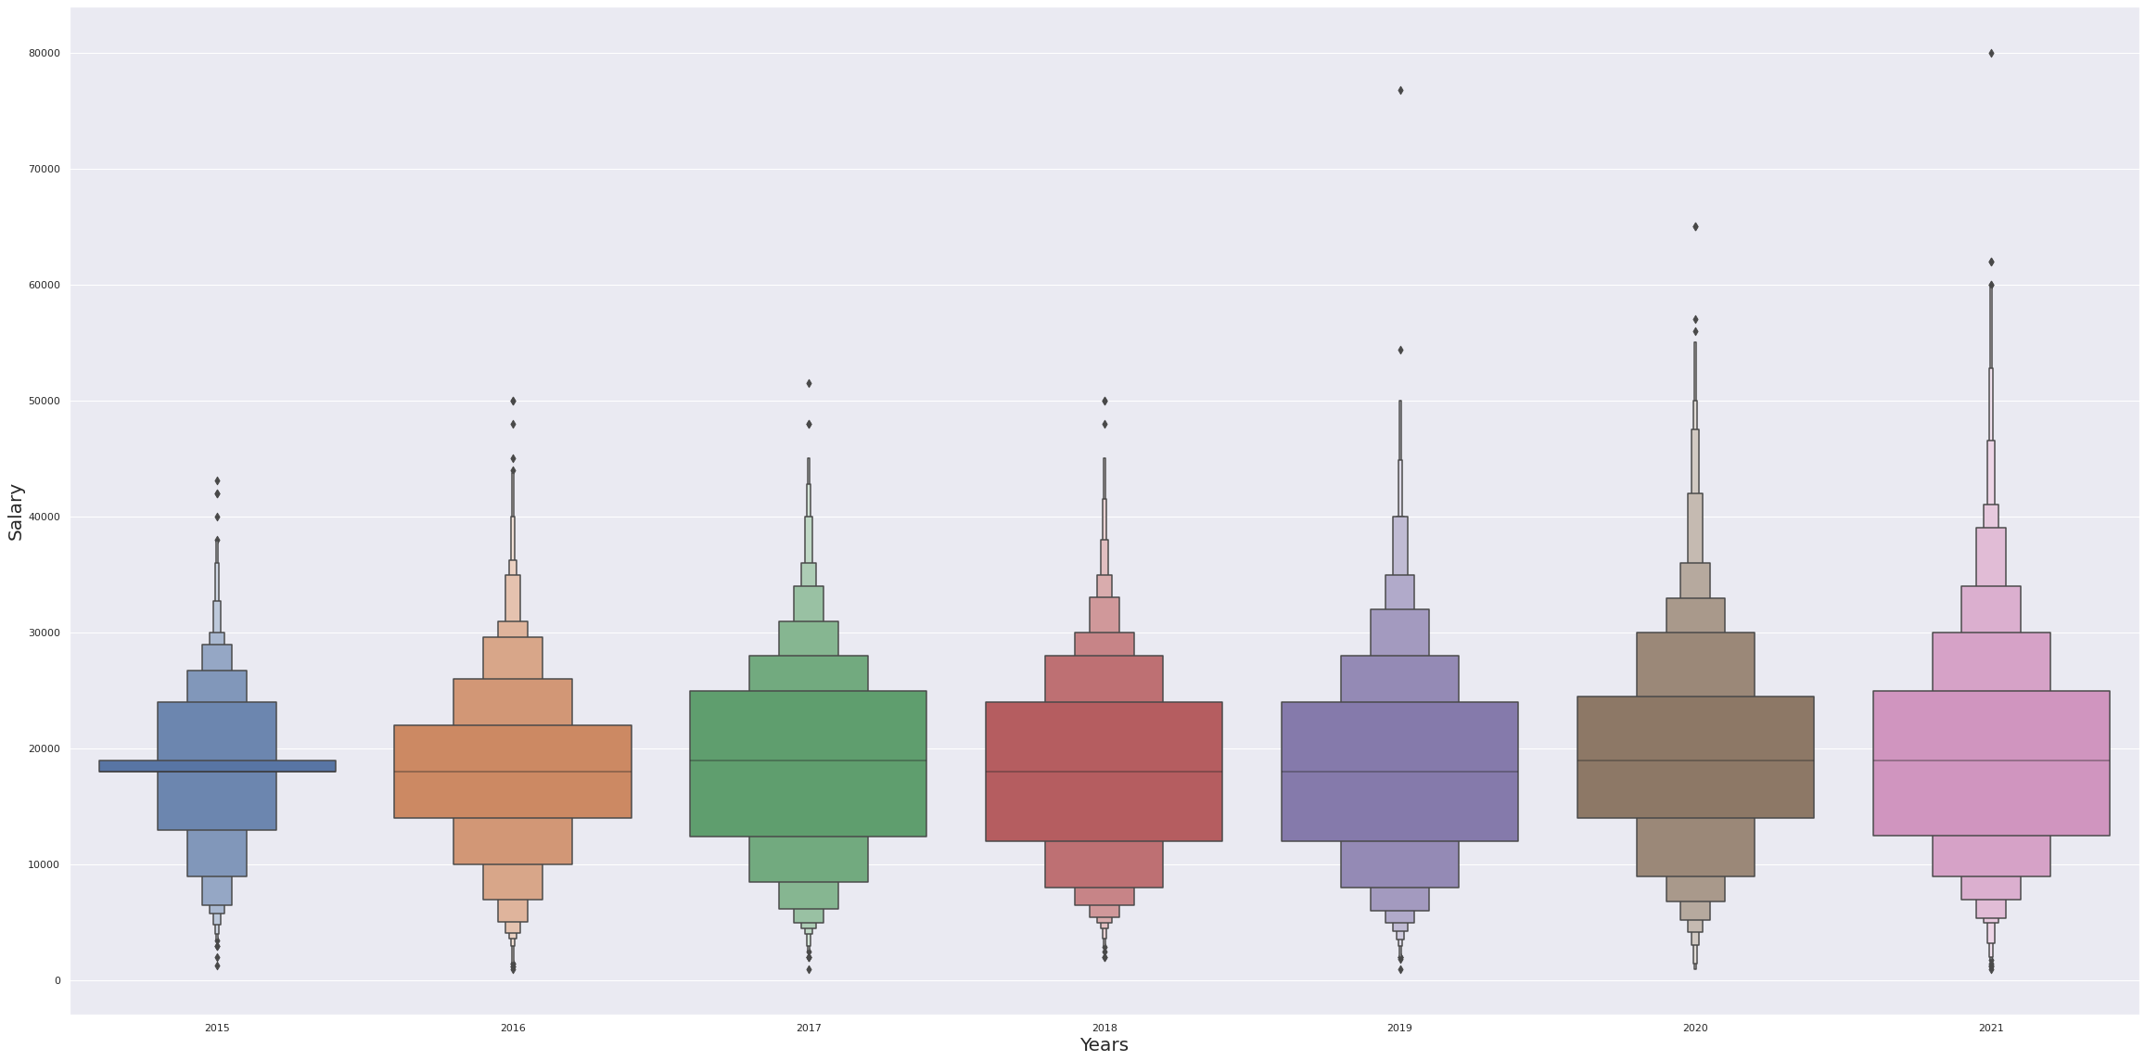
EXPLORATORY DATA ANALYSIS
High Tech Data
Notes:
https://www.freepik.com/free-vector/business-meeting-sketch-concept-with-top-view-human-hands-with-office-objects_2873560.htm#page=1&query=sketch&position=28

Slide 22
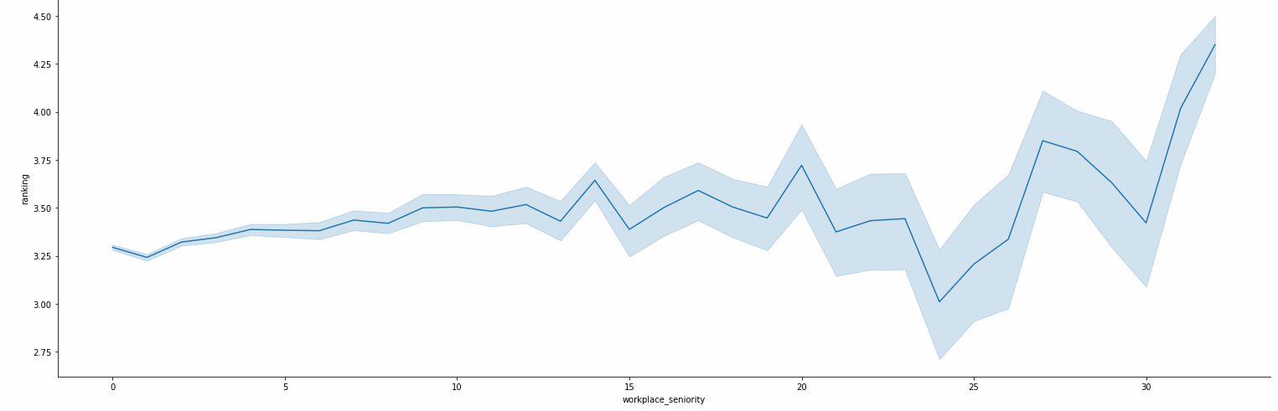
EXPLORATORY DATA ANALYSIS
Whole Economy
Notes:
https://www.freepik.com/free-vector/business-meeting-sketch-concept-with-top-view-human-hands-with-office-objects_2873560.htm#page=1&query=sketch&position=28

Slide 23
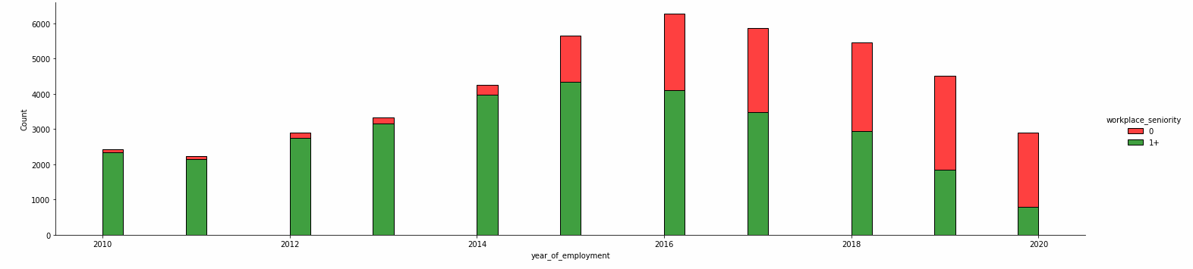
EXPLORATORY DATA ANALYSIS
Whole Economy
Notes:
https://www.freepik.com/free-vector/business-meeting-sketch-concept-with-top-view-human-hands-with-office-objects_2873560.htm#page=1&query=sketch&position=28

Slide 24
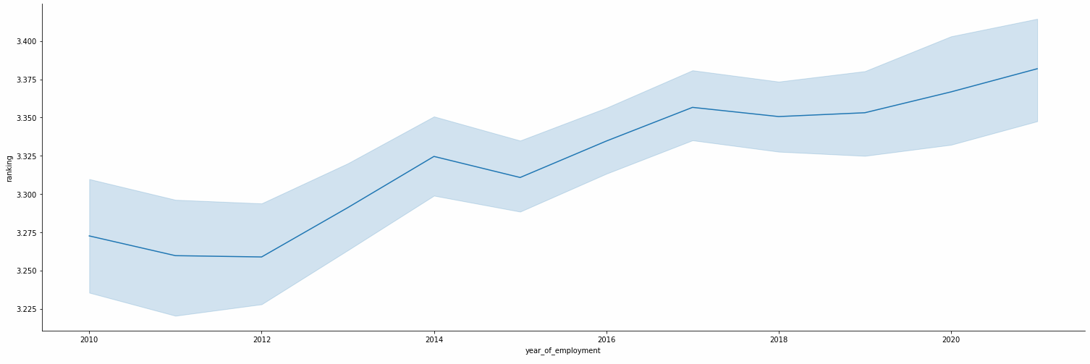
EXPLORATORY DATA ANALYSIS
Whole Economy
Notes:
https://www.freepik.com/free-vector/business-meeting-sketch-concept-with-top-view-human-hands-with-office-objects_2873560.htm#page=1&query=sketch&position=28

Slide 25

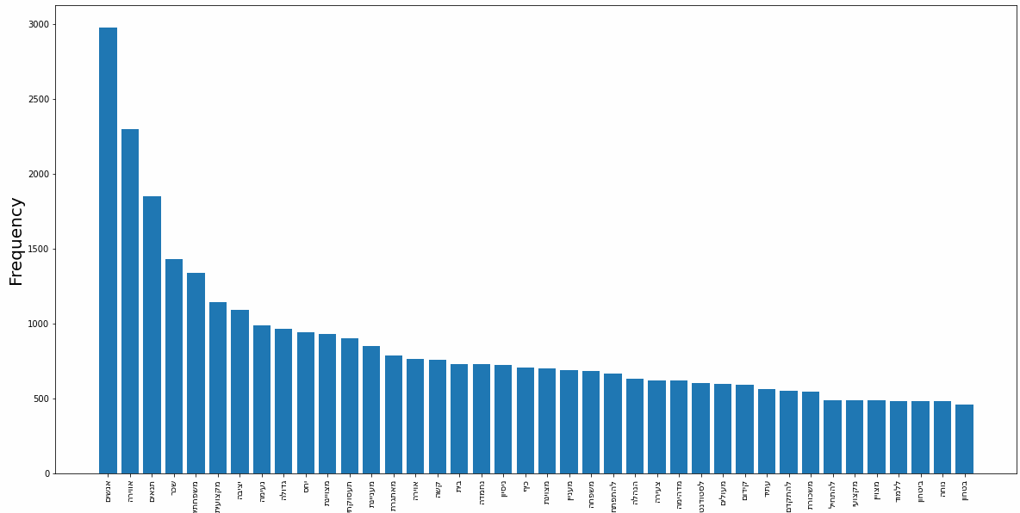
EXPLORATORY DATA ANALYSIS
Whole Economy
Notes:
https://www.freepik.com/free-vector/business-meeting-sketch-concept-with-top-view-human-hands-with-office-objects_2873560.htm#page=1&query=sketch&position=28

Slide 26

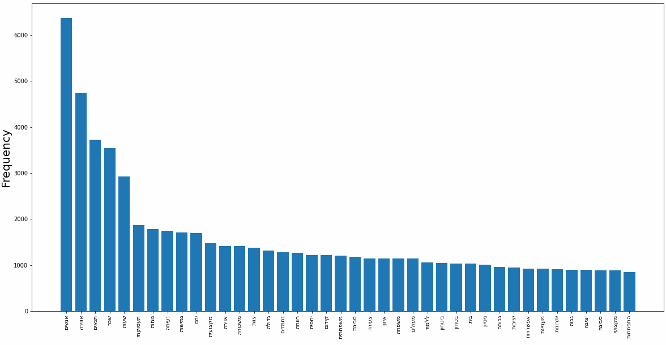
EXPLORATORY DATA ANALYSIS
Whole Economy
Notes:
https://www.freepik.com/free-vector/business-meeting-sketch-concept-with-top-view-human-hands-with-office-objects_2873560.htm#page=1&query=sketch&position=28

Slide 27

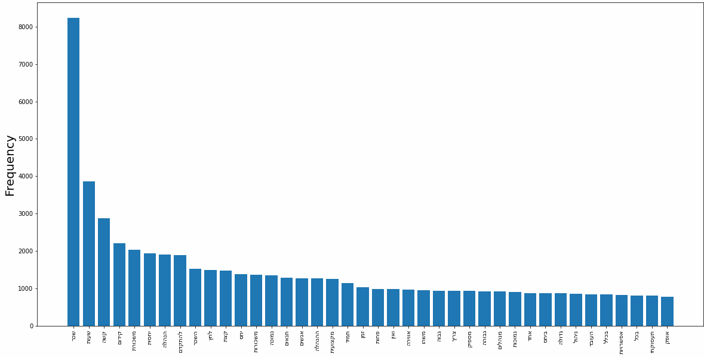
EXPLORATORY DATA ANALYSIS
Whole Economy
Notes:
https://www.freepik.com/free-vector/business-meeting-sketch-concept-with-top-view-human-hands-with-office-objects_2873560.htm#page=1&query=sketch&position=28

Slide 28

Machine Learning
Notes:
https://www.freepik.com/free-vector/business-meeting-sketch-concept-with-top-view-human-hands-with-office-objects_2873560.htm#page=1&query=sketch&position=28

Slide 29
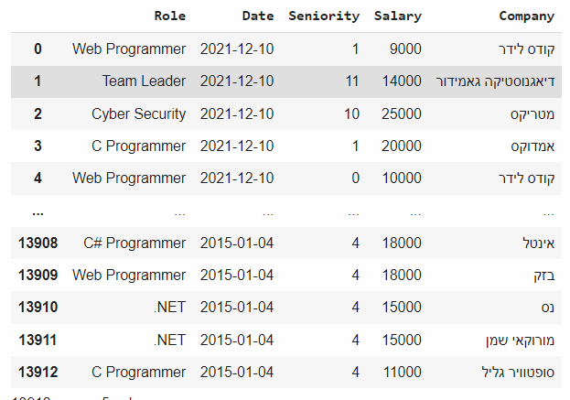
Machine Learning
Our first question is "Can we predict the salaries in the Israeli High-Tech Industry?“, We decided this was a regression problem.
Notes:
https://www.freepik.com/free-vector/business-meeting-sketch-concept-with-top-view-human-hands-with-office-objects_2873560.htm#page=1&query=sketch&position=28

Slide 30
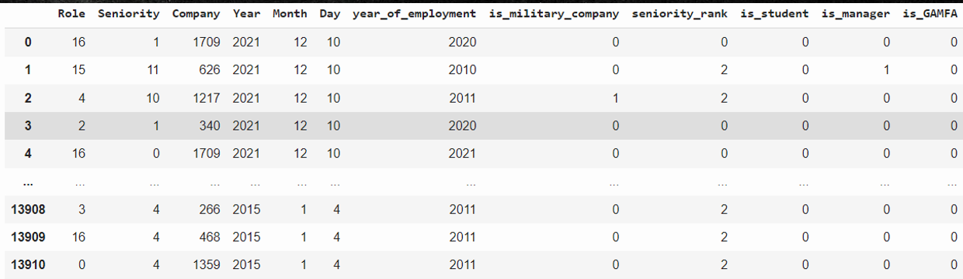
Machine Learning
To improve the prediction we added additional columns
is_military_company - If this is a security company – 1, else – 0
seniority_rank - The greater the employee's seniority, the higher the rank
Is_student – If the employee is a student – 1, else – 0
Is_manager - If the employee in a managerial position -1, else – 0
Is_GAMFA – If the employee is employed by one of the companies: Google, Amazon, Microsoft, Facebook or Apple – 1 , else 0.
Notes:
https://www.freepik.com/free-vector/business-meeting-sketch-concept-with-top-view-human-hands-with-office-objects_2873560.htm#page=1&query=sketch&position=28

Slide 31
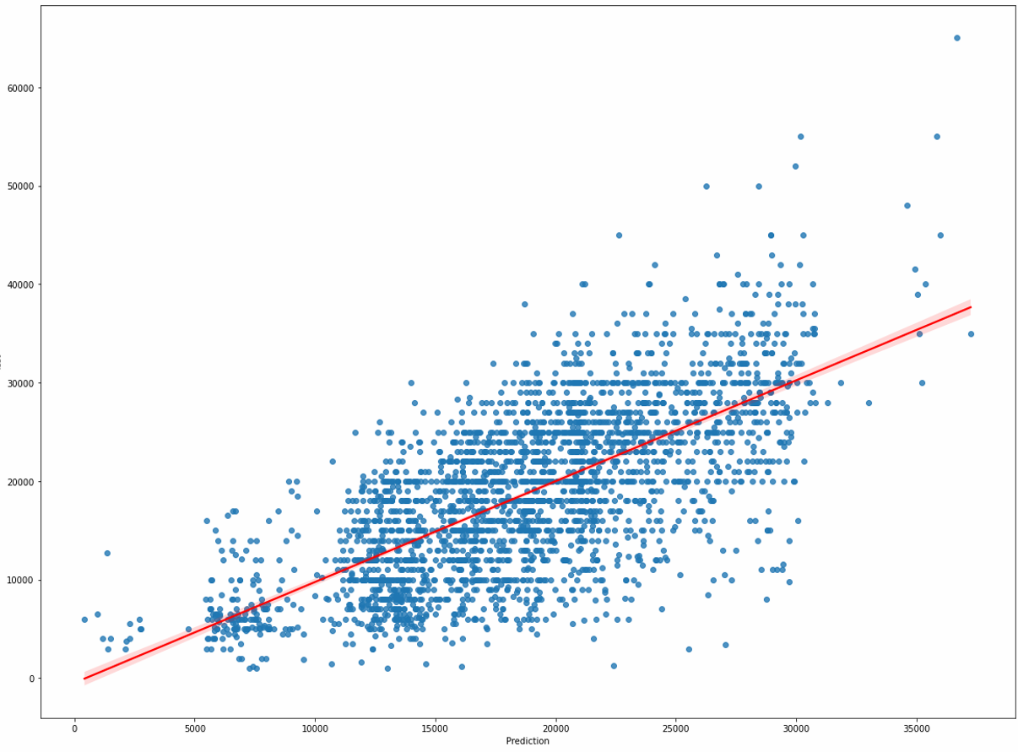
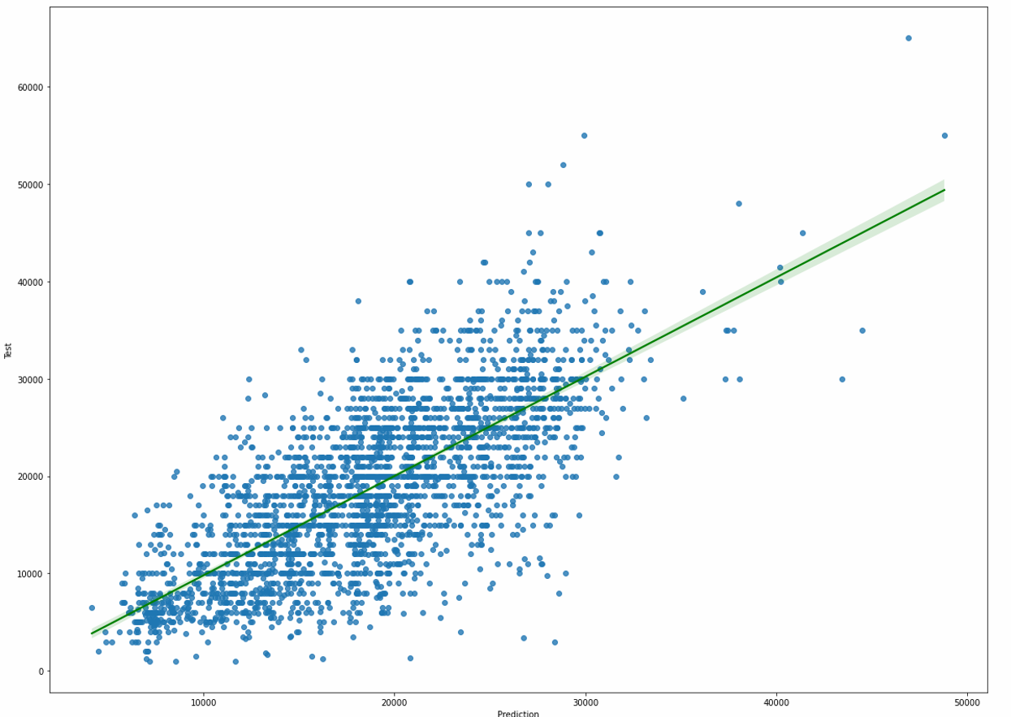


Machine Learning
We used 2 regression models: Random Forest Regressor and Linear Regression
The prediction using Random Forest Regressor is slightly better than Linear Regressor, our prediction is made in thousands of shekels.
Notes:
https://www.freepik.com/free-vector/business-meeting-sketch-concept-with-top-view-human-hands-with-office-objects_2873560.htm#page=1&query=sketch&position=28

Slide 32
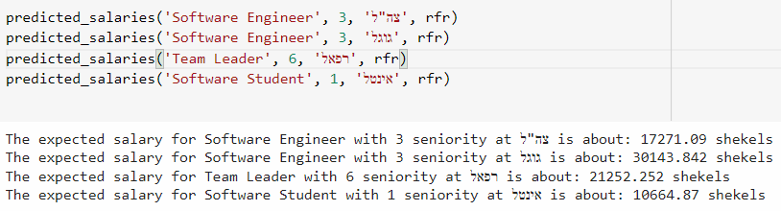
Machine Learning
The prediction model we received received r2_score which is quite reasonable, we conclude that the result we received is due to the fact that we predict in thousands of shekels
We made several predictions according to the prediction model we received using Random Forest Regressor, here are some of the results, which do seem to make a lot of sense:
Notes:
https://www.freepik.com/free-vector/business-meeting-sketch-concept-with-top-view-human-hands-with-office-objects_2873560.htm#page=1&query=sketch&position=28

Slide 33
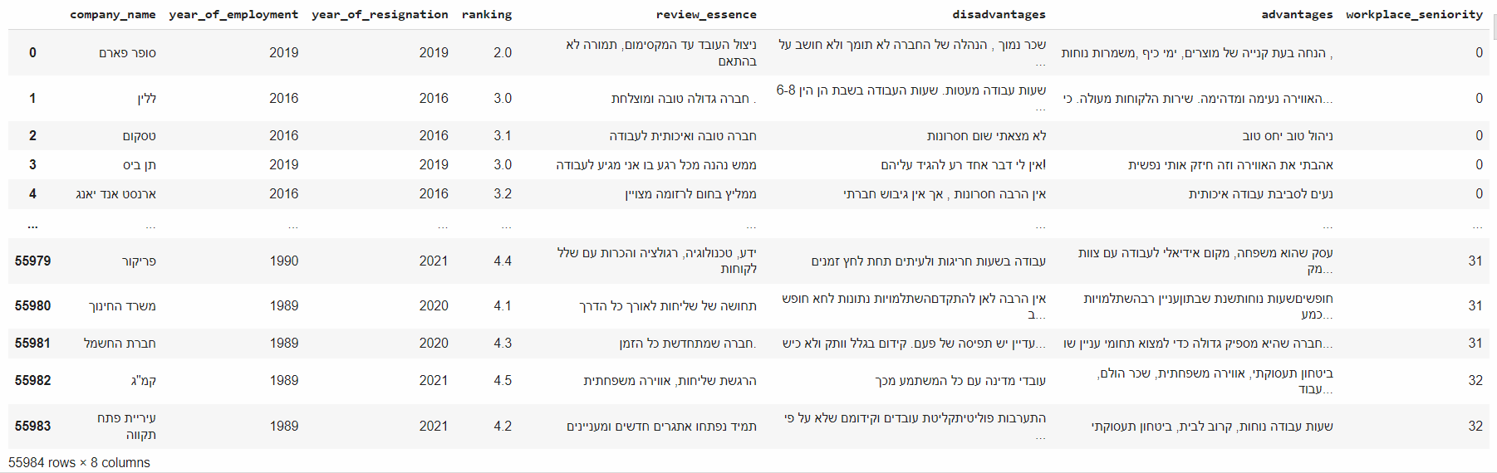
Machine Learning
Our second question is "Can we predict the early resignation of workers in the Israeli economy?”, We decided this was a classification problem.
Early resignation - An employee who left his place of work before completing a full year of work.
Notes:
https://www.freepik.com/free-vector/business-meeting-sketch-concept-with-top-view-human-hands-with-office-objects_2873560.htm#page=1&query=sketch&position=28

Slide 34
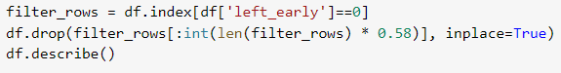

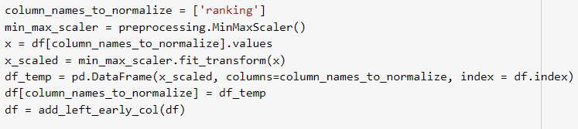
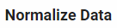
Machine Learning
We added more columns to improve the prediction.
negative_review_potential - we performed a rather superficial test to distinguish between negative and positive reviews using the word 'no', if the word then appears 1, otherwise 0.
is_satisfied - if the ranking is higher than 4.0 then 1, otherwise 0
We balanced the data to avoid biased predictions, we removed some of the data to make it 50% of the "early resignation" category and 50% of the other category.
We normalized the Ranking column.
Notes:
https://www.freepik.com/free-vector/business-meeting-sketch-concept-with-top-view-human-hands-with-office-objects_2873560.htm#page=1&query=sketch&position=28

Slide 35
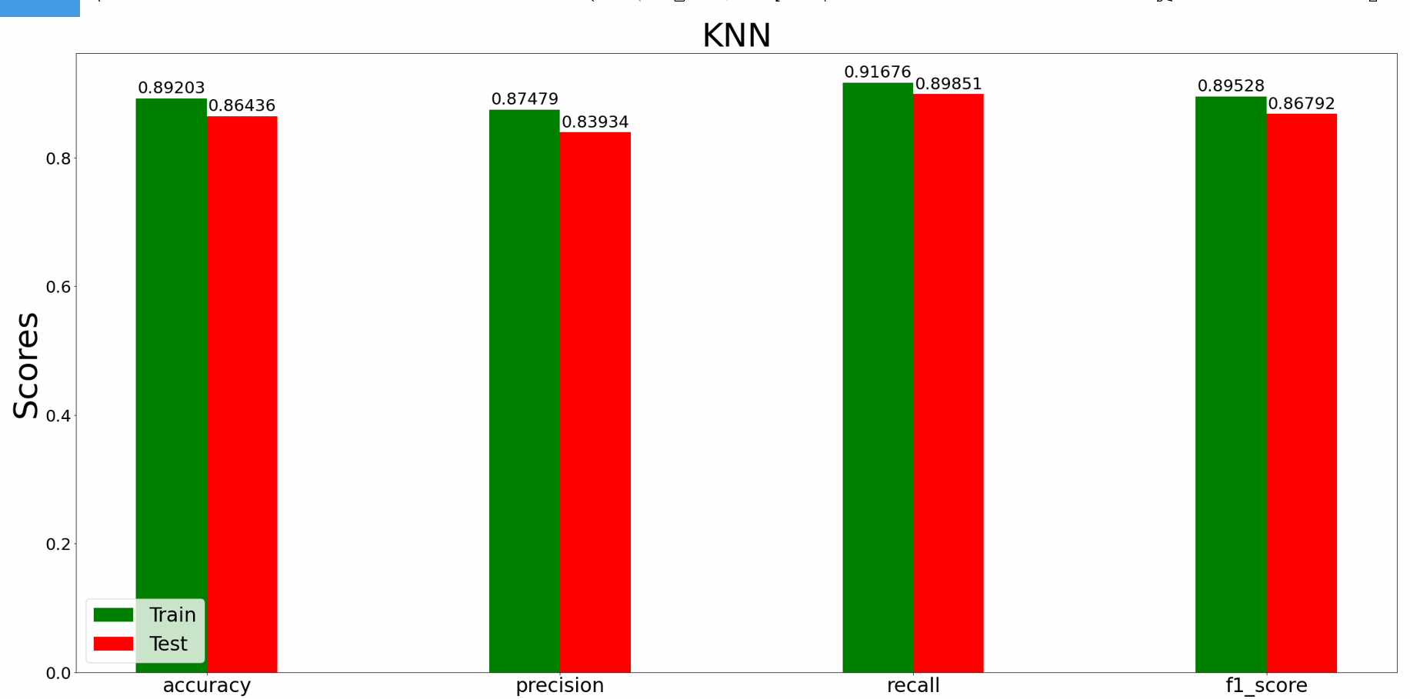
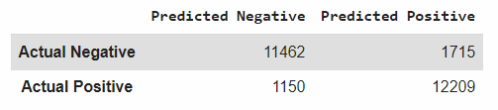
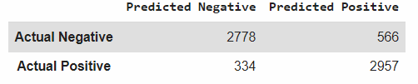
Machine Learning
We used 6 classification models: Logistic Regression, GaussianNB, Decsion Tree, KNN, Random Forest and SVM.
The prediction using KNN is slightly better than others.
Notes:
https://www.freepik.com/free-vector/business-meeting-sketch-concept-with-top-view-human-hands-with-office-objects_2873560.htm#page=1&query=sketch&position=28

Slide 36
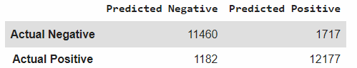
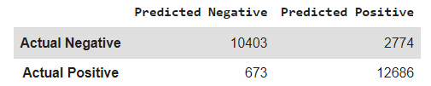
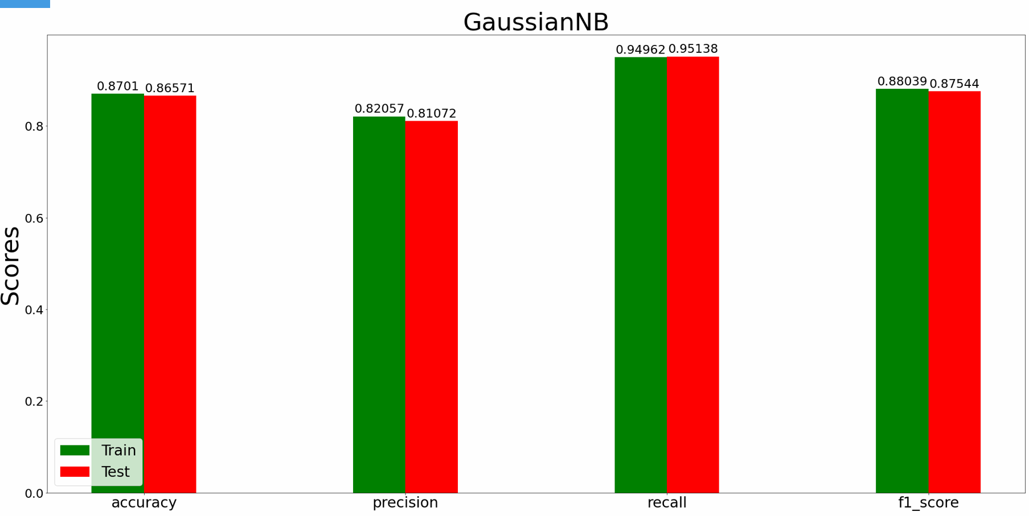
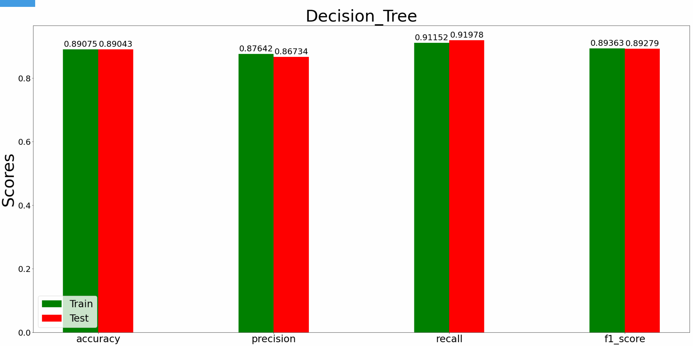
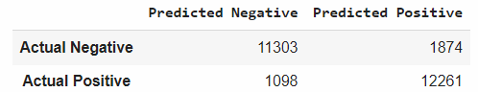
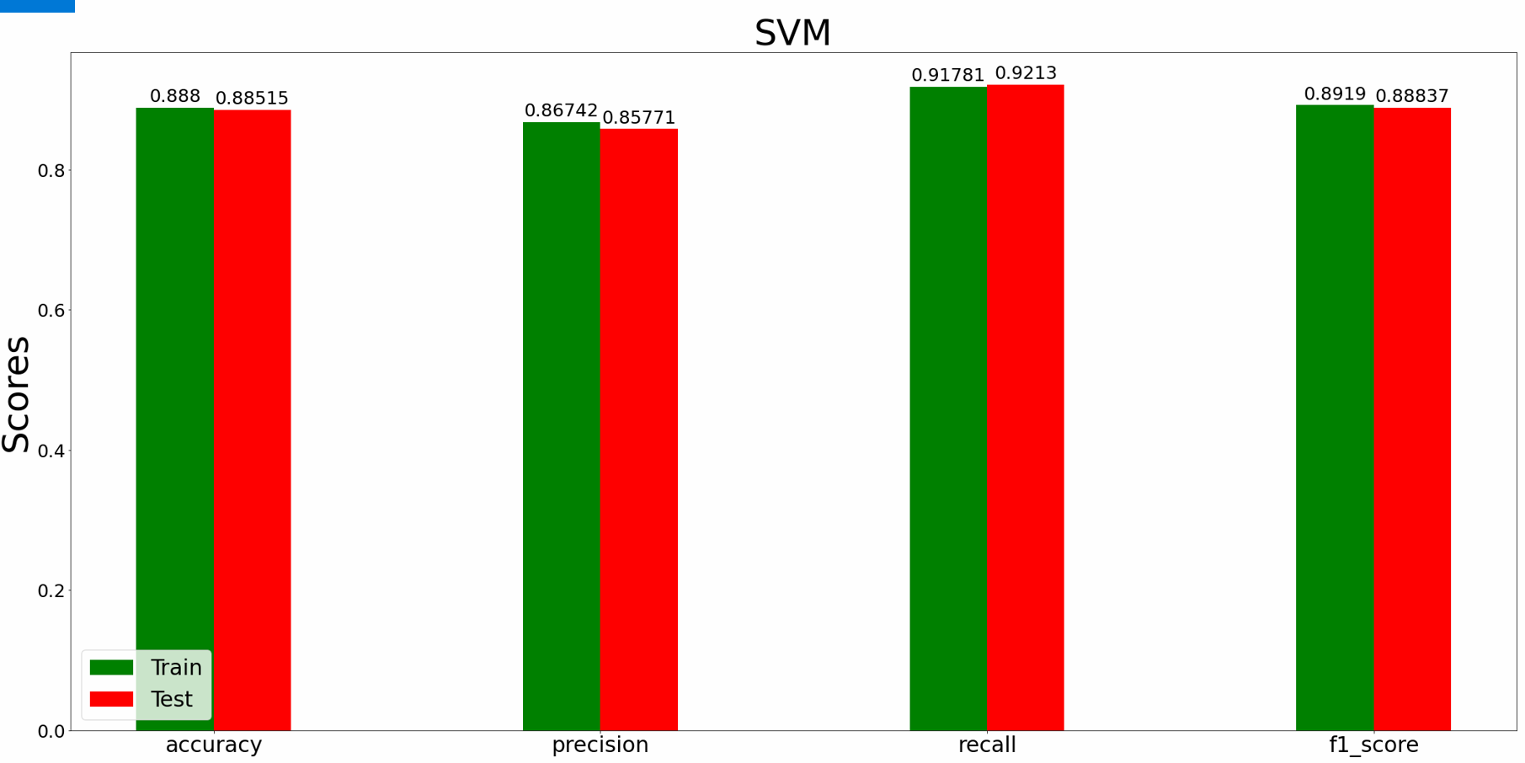
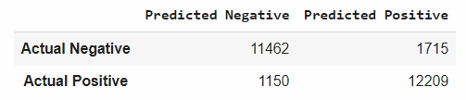
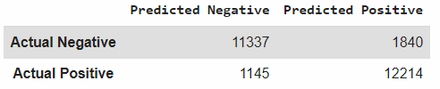
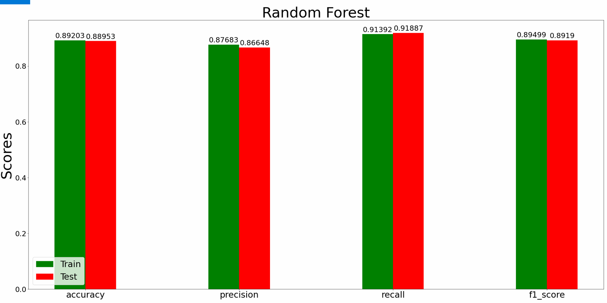
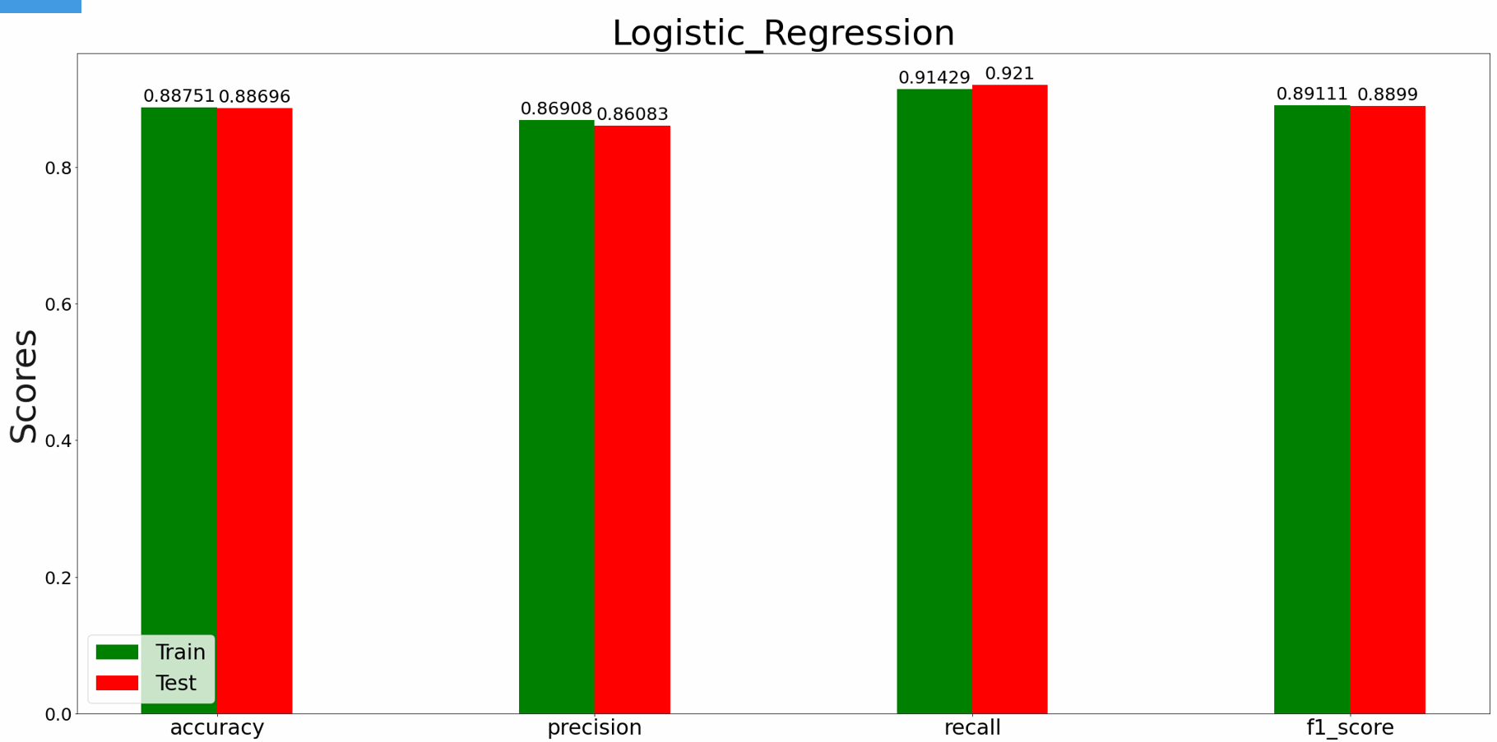
Machine Learning - Other Models
Notes:
https://www.freepik.com/free-vector/business-meeting-sketch-concept-with-top-view-human-hands-with-office-objects_2873560.htm#page=1&query=sketch&position=28

Slide 37
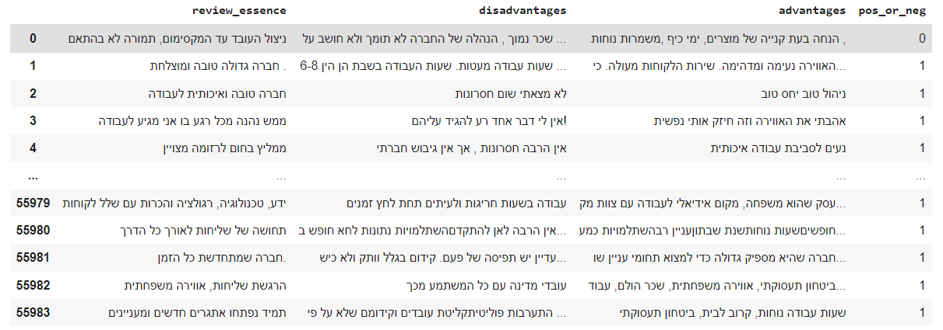
Machine Learning
Our third question is "Can we predict whether an employee is satisfied by their review?” , This is of course a text classification problem.
Notes:
https://www.freepik.com/free-vector/business-meeting-sketch-concept-with-top-view-human-hands-with-office-objects_2873560.htm#page=1&query=sketch&position=28

Slide 38
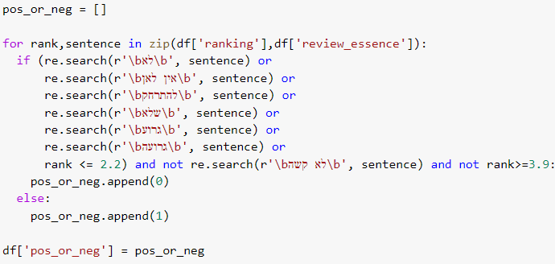
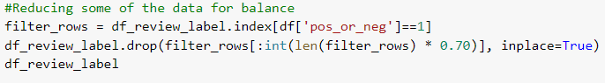
Machine Learning
We added more columns to improve the prediction.
pos_or_neg – check whether the rating passes rating 3.9 and not include keywords, We classify as satisfied (1) otherwise, we will classify as dissatisfied (0), We were able to classify the vast majority of responses to negative and positive, with very few errors.
We balanced the data to avoid biased predictions, we removed some of the data to make it 50% of the “positive review" category and 50% of the “negative review”.
Notes:
https://www.freepik.com/free-vector/business-meeting-sketch-concept-with-top-view-human-hands-with-office-objects_2873560.htm#page=1&query=sketch&position=28

Slide 39
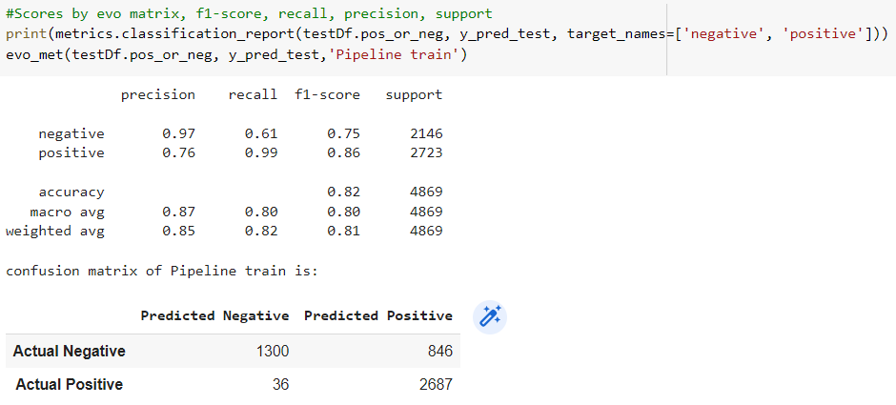
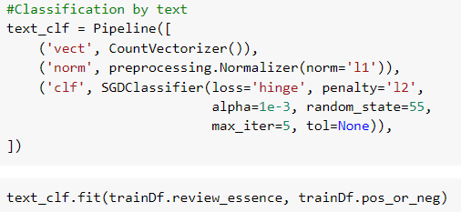
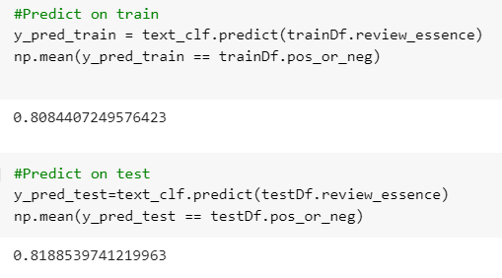
Machine Learning
We splited the information into train and test
We used a Pipeline containing CounterVectorizer, Normalizer with and SGDClassifier
We built the prediction model whether the review that the employee wrote is negative or positive, we got a pretty good model
Notes:
https://www.freepik.com/free-vector/business-meeting-sketch-concept-with-top-view-human-hands-with-office-objects_2873560.htm#page=1&query=sketch&position=28

Slide 40
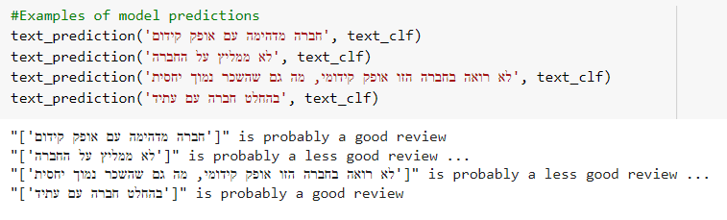
Machine Learning
We ran the prediction model on a few random reviews, we got the results we were expecting
Notes:
https://www.freepik.com/free-vector/business-meeting-sketch-concept-with-top-view-human-hands-with-office-objects_2873560.htm#page=1&query=sketch&position=28

Slide 41

Conclusions
Notes:
https://www.freepik.com/free-vector/business-meeting-sketch-concept-with-top-view-human-hands-with-office-objects_2873560.htm#page=1&query=sketch&position=28

Slide 42



Conclusions
Contrary to popular belief, We see that a significant proportion of the larger companies tend to accept young and inexperienced employees, and give opportunities to potential employees of all ages
Despite the tendency to resign early, in recent years people have been expressing higher job satisfaction than in the past.
There are many issues that are important to employees at work, but the things that came up the most are: people, enivorment, work benefits, salary, family.
Despite the high wages in high-tech compared to the rest of the economy, the wage gaps between different positions and different companies are very noticeable.
The issues that most bother employees in the economy are: low wages, long hours, inattentive management, lack of promotion and pressure at work
Resignation before completing a full year of work (early resignation) has become a very common phenomenon in recent years.
Notes:
https://www.freepik.com/free-vector/sketchy-business-team_830664.htm#page=4&query=sketch+meeting&position=48

Slide 43



GitHub link

